Slide 1
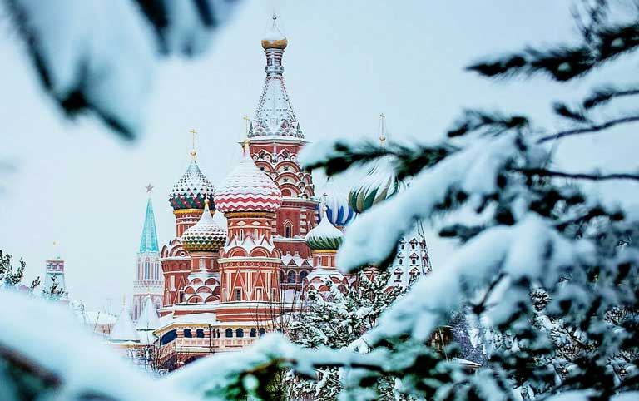

Winter school MIEM HSE 2026
Mastering modern science: quantum, materials and computational frontiers

Slide 2

The main idea of the program
These courses immerse students in the cutting-edge fields of modern physics, materials science, and computational technology, combining fundamental principles with practical methods.
From quantum mechanics and strange superconductivity to materials design for solar energy, from multiscale numerical simulations and asymptotic approaches to artificial intelligence capable of tackling complex physics problems—each course demonstrates how modern tools and theories help us understand, model, and create new technologies.
Special emphasis is placed on the interplay between classical physics, computational methods, and machine learning, enabling students and engineers to see the connections between fundamental laws, experimental results, and innovative applications in quantum technologies, energy, and engineering.

Slide 3
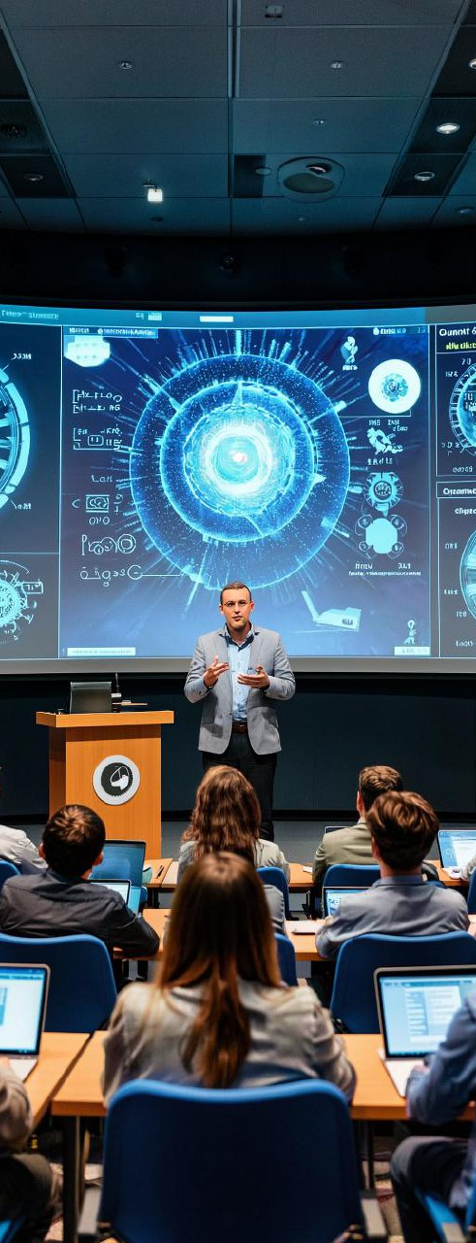
What will you learn?
1. How to Train Your AI to Do Physics (and Not Mess It Up)
2. Designing Tomorrow’s Materials: From Quantum Rules to Machine Learning Tools
3. From Atoms to Structures: The What, Why, and How of Multiscale Calculations
4. How Quantum Computation and Communication Really Work
5. Quantum Dots Explained: Why the Simplest Quantum Objects Are so Complex
6. From Zero Resistance to Quantum Power: Superconducting Electronics and Their Future
7. Strange Superconductors: From Type I and II to Self-Organized Turing Patterns
8. From Silicon to Perovskites: How to Pick Materials for Solar Energy
9. Asymptotic Thinking: Cracking Linear and Nonlinear Problems the Smart Way

Slide 4
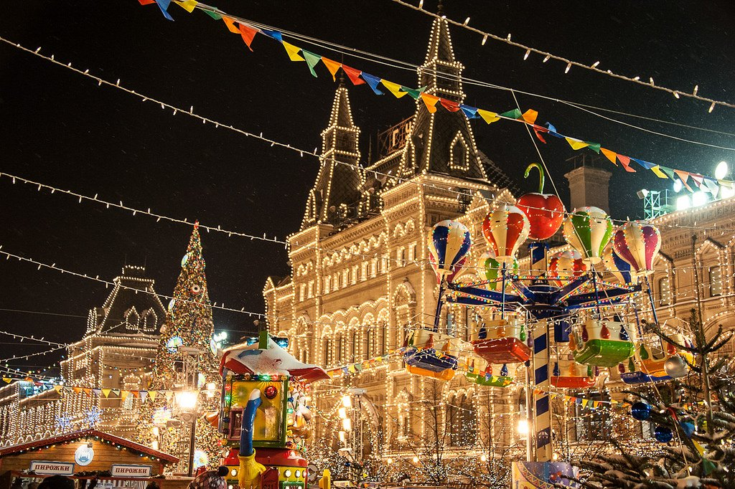
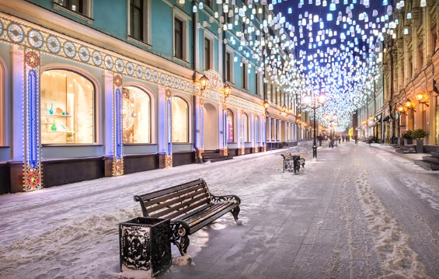
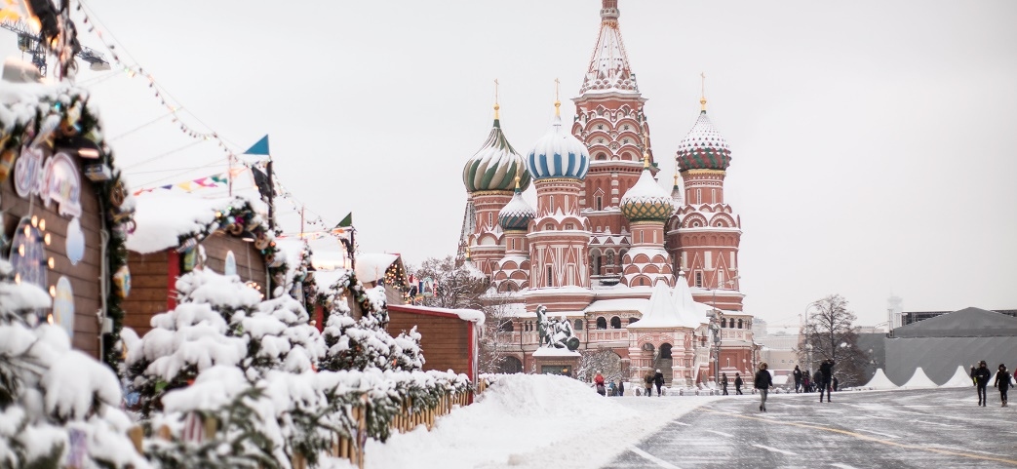
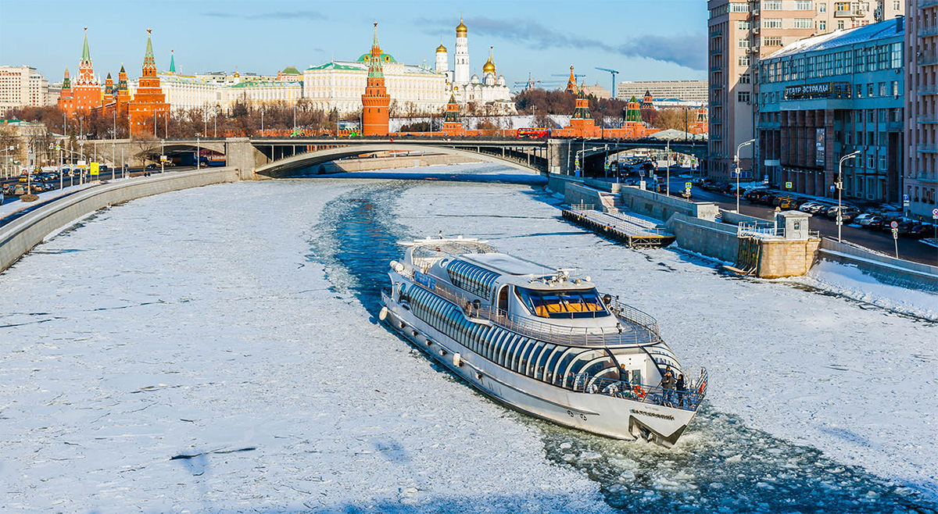
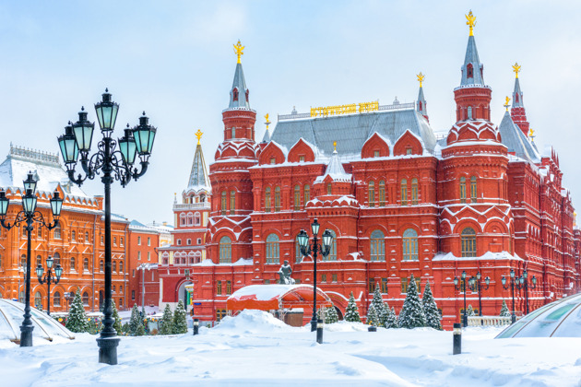
What will you see

Slide 5




Why us?
87 PLACE IN THE WORLD
THE Young University Rankings. The only Russian university in the top 100.
1st place in Russia
Employer Reputation Ranking.
1st place in Russia
Best universities in Russia according to hh.ru.
TOP-11 Globally Gold Group
THE Online Learning Rankings the only Russian university in the ranking.
135 PLACE IN THE WORLD
Three University Missions4th place among Russian universities
44 appearances QS, THE and ARWU subject rankings
2nd place in number of ranked subjects among Russian universities
3rd place in number of subject ranked in the TOP 100 among Russian universities

Slide 6
Our professors
Dr. Viacheslav Neverov
Prof. Vasily Stolyarov
Prof. Alexei Vagov
Ass. Prof. Tiago Saraiva
Prof. Andrey Vasenko
Dr. Grigory Smirnov
Prof. Alexei Kartsev
Prof. Arkady Shanenko
Prof. Vladimir Danilov
Assistant Professor of School of Electronic Engineering
Head of Laboratory of Mathematical Methods in Natural Science, Research Professor of School of Applied Mathematics
Professor of School of Electronic Engineering, Chief Research Fellow of Centre for Quantum Metamaterials
Research Fellow of Quantum Nanoelectronics Laboratory, Research Fellow of Centre for Quantum Metamaterials
Laboratory Head of International Laboratory for Supercomputer Atomistic Modelling and Multi-scale Analysis, Associate Professor of School of Applied Mathematics
Professor of MIPT, Doctor of Physical and Mathematical Sciences, Director of the Center for Mesophysics of MIPT
Professor of School of Electronic Engineering, Director of Centre for Quantum Metamaterials
Professor of School of Electronic Engineering, Leading Research Fellow, Deputy Head of Quantum Nanoelectronics Laboratory
Research Fellow of Centre for Quantum Metamaterials

Slide 7
The program pricing plan
TUITION FEE
13 000 ¥
WHAT IS INCLUDED IN THE COURSE PRICE:
Lectures and workshops
Hotel accommodation
Meals (breakfast, lunch)
Lectures and workshops
Constant communication with teachers and assistant
Excursions
Certificate upon completion of the course
WHAT IS NOT INCLUDED IN THE COURSE PRICE:
Flights
Personal expenses

Slide 8
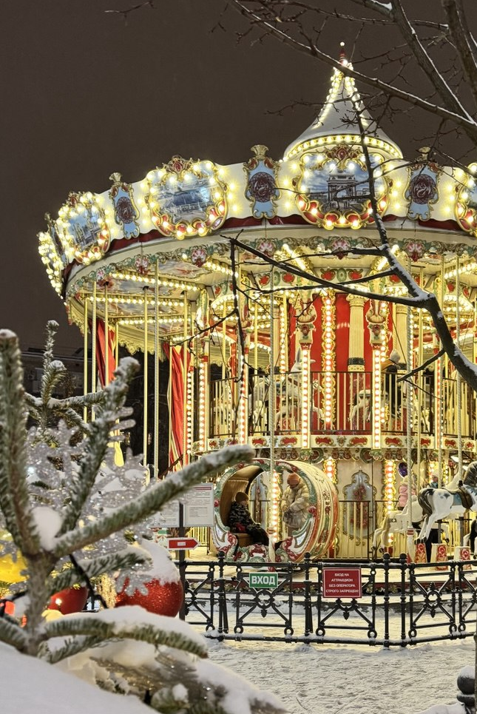
Important dates
October 1, 2025 – the start of the admission
December 1, 2025 – the end of admission on the program
December 1 – 30, 2025 – HSE preparing agreements
December 10, 2025 – January 15, 2026 – the payment dates
February 1, 2026 – meeting of students at the airport and check-in at the hotel
February 2 – February 10, 2026 – study days in HSE, excursions and extracurricular activities
February 10 – closing ceremony
February 11 – departure

Slide 9
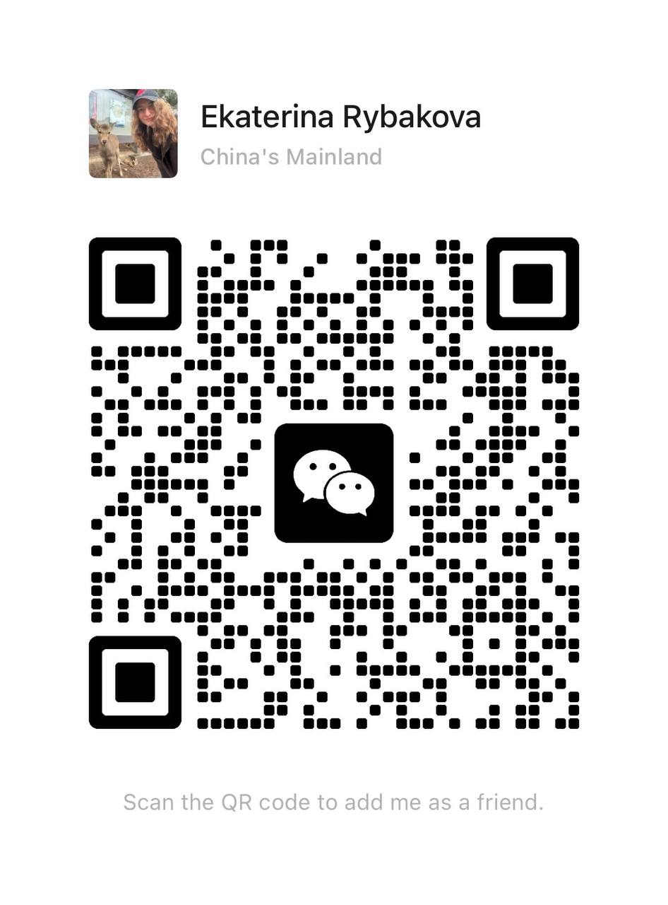
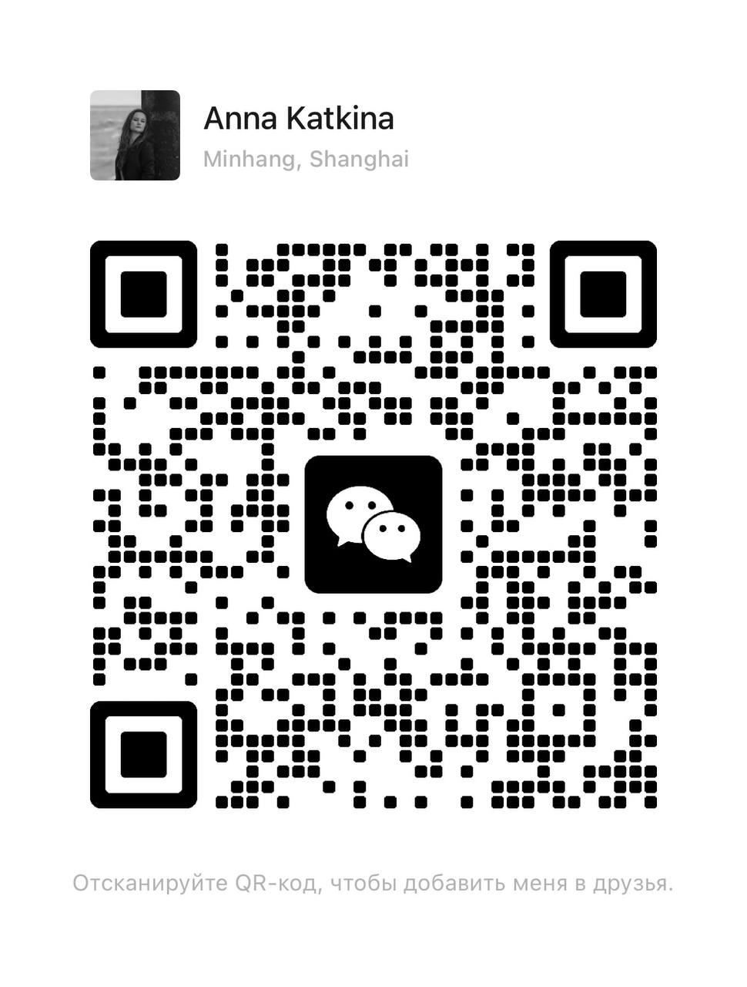
PLEASE CONTACT US!
If you have any question, feel free contact us via email or WeChat
egrybakova@hse.ru
aklinovskaya@hse.ru

