Slide 1
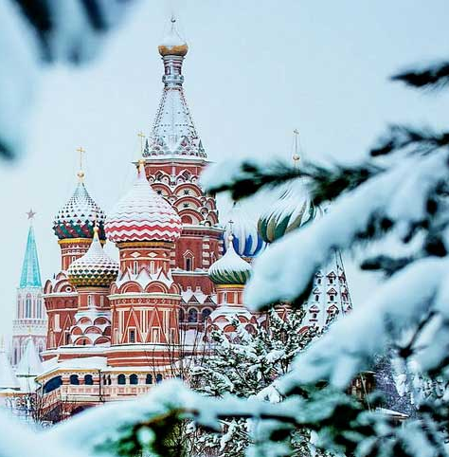

Winter school MIEM HSE 2026
Exploration of CubeSats systems

Slide 2
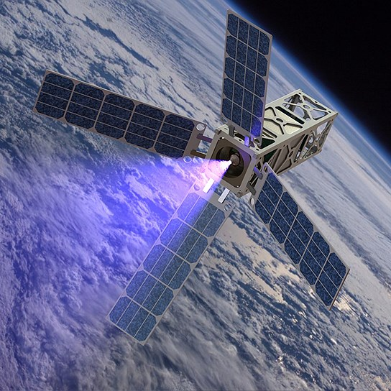
THE MAIN IDEA OF THE PROGRAM
This course explores CubeSat systems—small satellites widely used in modern space research and development. CubeSats open up new opportunities for educational projects, scientific experiments, Earth monitoring, and other applications. Participants will gain comprehensive knowledge and practical skills in satellite design and assembly, and become familiar with key technologies and trends in the field of small spacecraft.
This course will be useful for technical professionals, space technology specialists, and anyone interested in earth remote sensing technologies who wants to gain a deeper understanding of satellite creation technologies and gain practical skills in this promising and developing field.

Slide 3
WHAT WILL YOU STUDY?
• A detailed overview of satellites developed by HSE, with an analysis of their design and functional features;
• A study of the theoretical aspects of working with CubeSats: system design principles, technologies used, software, launch and operation features;
• Practical training on assembling a satellite kit based on a 1U CubeSat – participants will be able to familiarize themselves with the main components and assemblies of the satellite;
• Working with the Orbicraft 3D satellite kit, which will consolidate acquired knowledge and develop practical skills in working with satellite components, as well as understand how various systems integrate into a single whole.

Slide 4
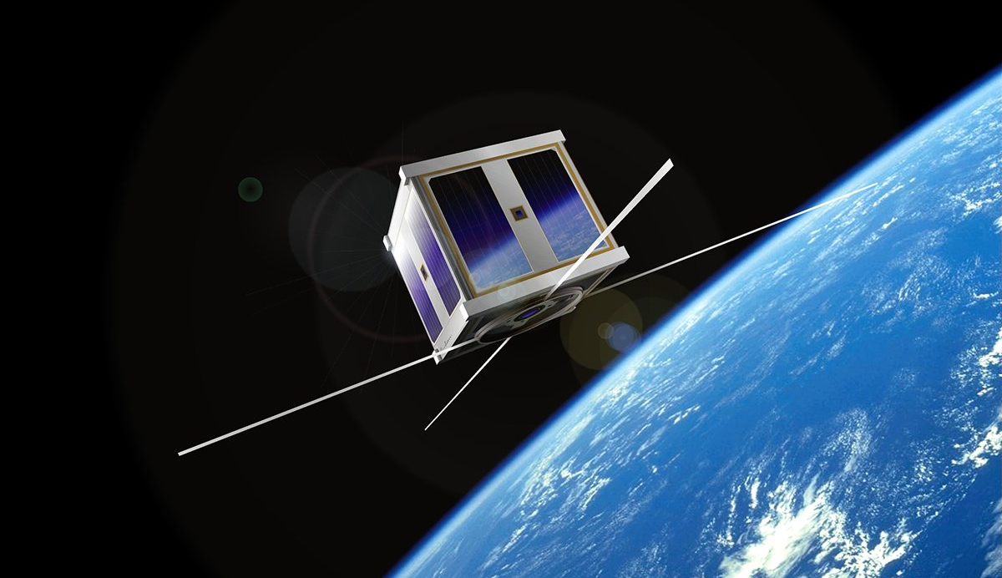

BENEFITS OF THE PROGRAM
• Understand the basic principles of small spacecraft design and construction;
• Learn about modern technologies used in the space industry;
• Gain experience working with real satellite designers and understand how key satellite systems function;
• Develop teamwork and project management skills essential for implementing space projects.

Slide 5

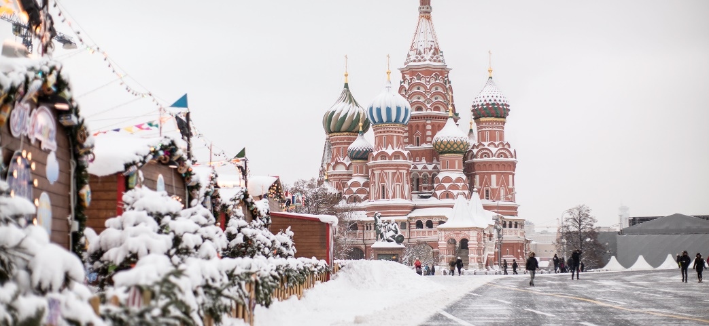
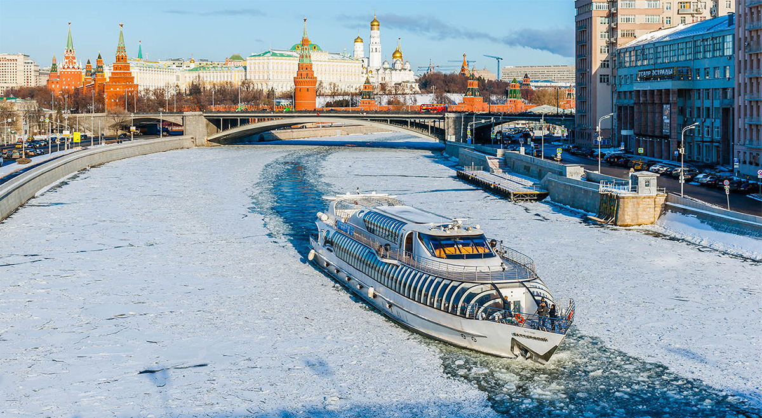
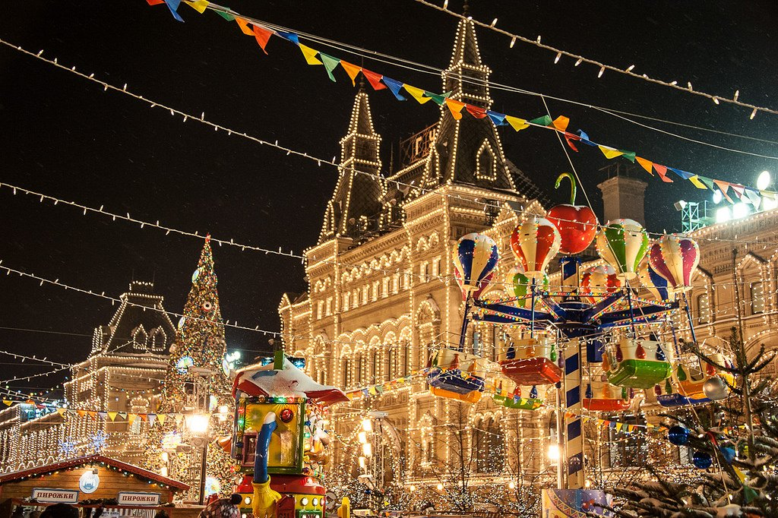


What will you see

Slide 6




WHY US?
87 PLACE IN THE WORLD
THE Young University Rankings. The only Russian university in the top 100.
1st place in Russia
Employer Reputation Ranking.
1st place in Russia
Best universities in Russia according to hh.ru.
TOP-11 Globally Gold Group
THE Online Learning Rankings the only Russian university in the ranking.
135 PLACE IN THE WORLD
Three University Missions4th place among Russian universities
44 appearances QS, THE and ARWU subject rankings
2nd place in number of ranked subjects among Russian universities
3rd place in number of subject ranked in the TOP 100 among Russian universities

Slide 7
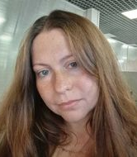
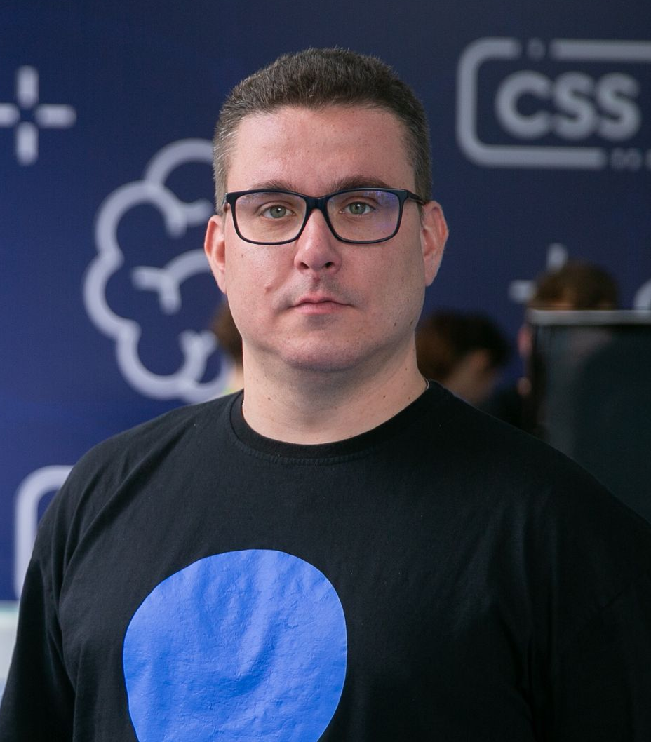
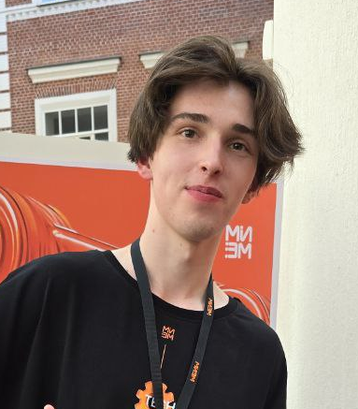
OUR PROFESSORS
Volkova Natalia
Abrameshin Dmitrii
Nosov Ivan
Lead Engineer, Laboratory of Space Vehicles and Systems' Functional Safety
Lead Engineer, Laboratory of Space Vehicles and Systems' Functional Safety
Research Intern, Laboratory of Space Vehicles and Systems' Functional Safety

Slide 8
TUITION FEE
13 000 ¥
WHAT IS INCLUDED IN THE COURSE PRICE:
Lectures and workshops
Hotel accommodation
Meals (breakfast, lunch)
Lectures and workshops
Constant communication with teachers and assistant
Excursions
Certificate upon completion of the course
WHAT IS NOT INCLUDED IN THE COURSE PRICE:
Flights
Personal expenses

Slide 9

IMPORTANT DATES
October 1, 2025 – the start of the admission
December 1, 2025 – the end of admission on the program
December 1 – 30, 2025 – HSE preparing agreements
December 10, 2025 – January 15, 2026 – the payment dates
February 1, 2026 – meeting of students at the airport and check-in at the hotel
February 2 – February 10, 2026 – study days in HSE, excursions and extracurricular activities
February 10 – closing ceremony
February 11 – departure

Slide 10
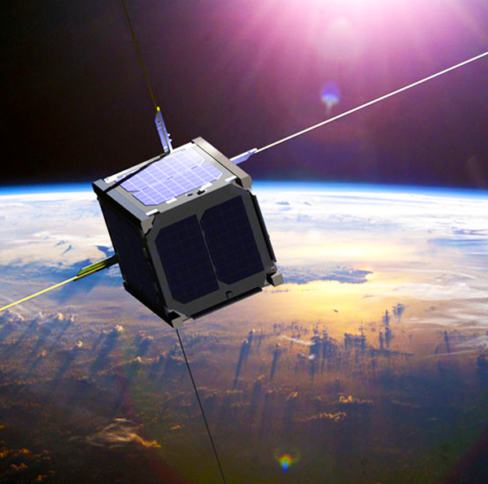

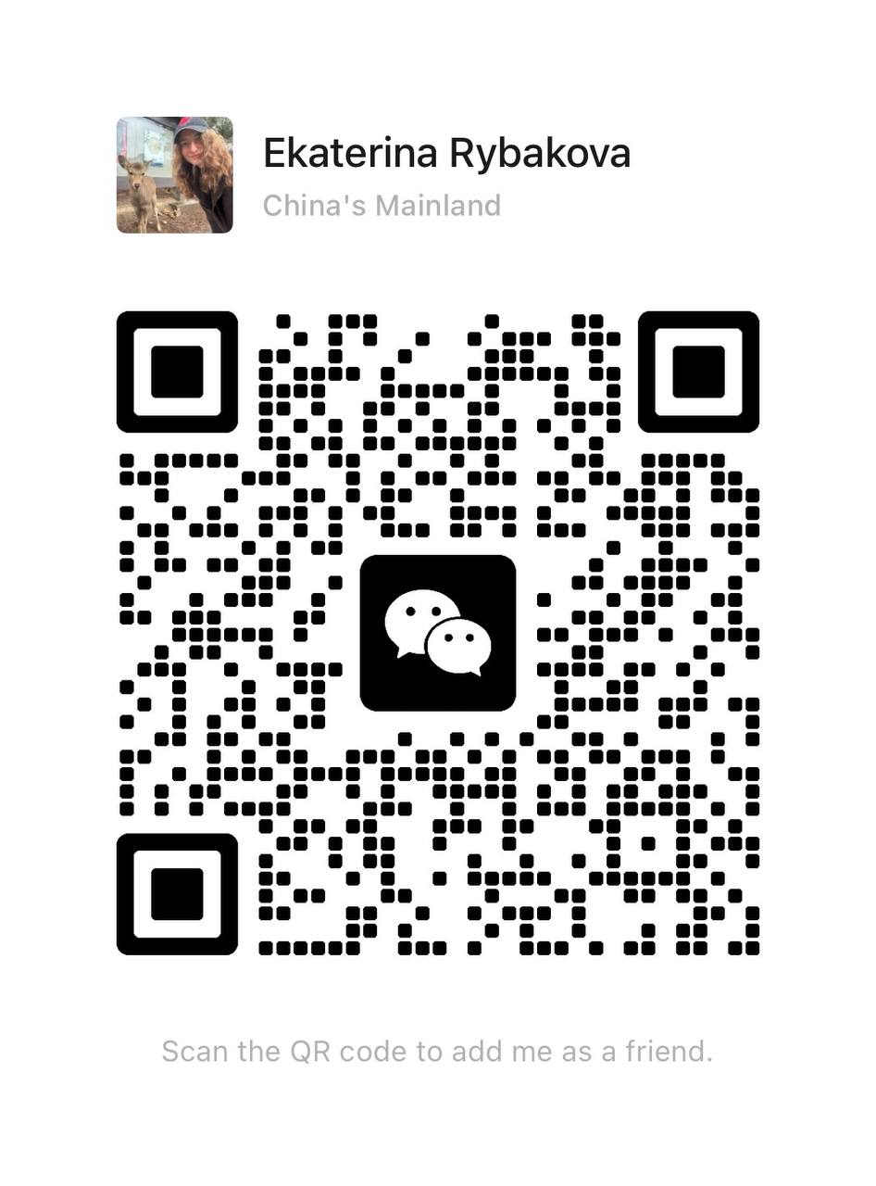
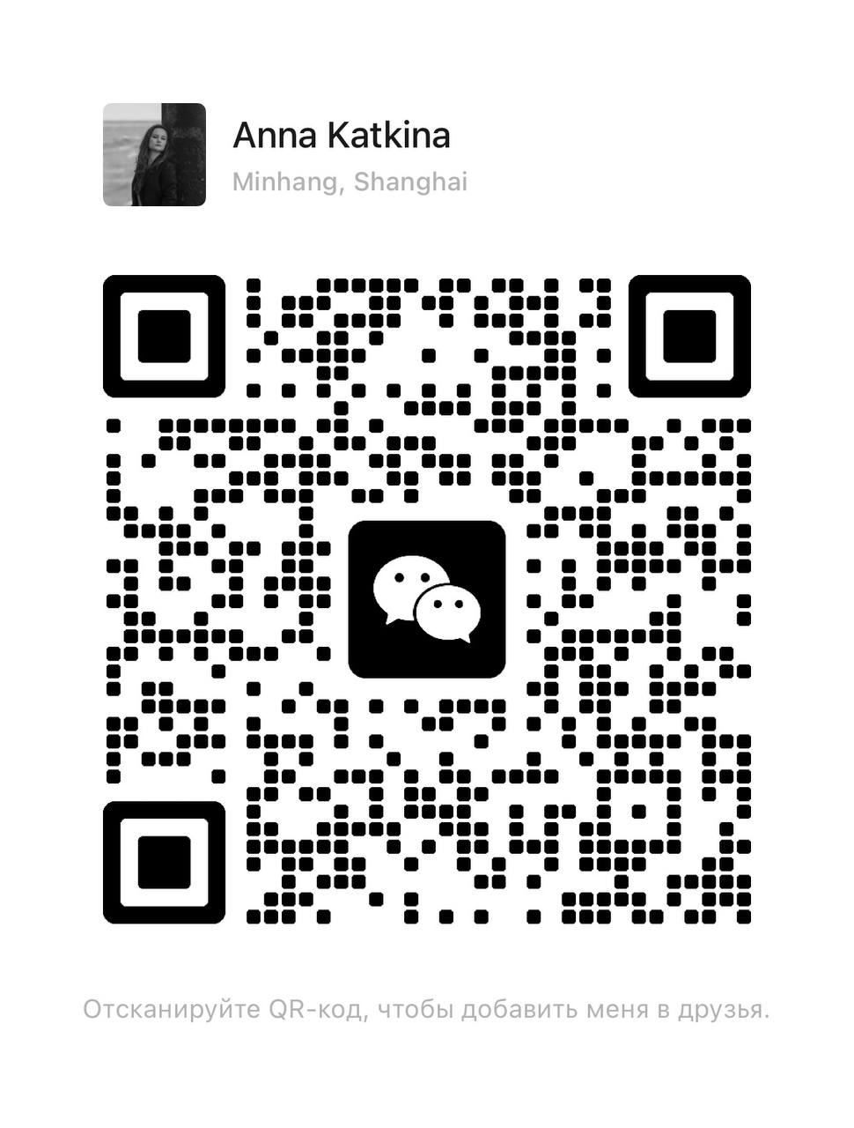
PLEASE CONTACT US!
If you have any question, feel free contact us via email or WeChat
egrybakova@hse.ru
aklinovskaya@hse.ru

